Slide 1

Three Rivers Curriculum Phase Three Final Report
Curriculum Reform Task Force Leadership
Nathalie Chen
Rachel Fogel
Alaina James
John Maier
Katie Maietta
Greg Null
Notes:
Overview:
With the Curriculum Committee’s approval of the Phase 2 plan in June 2022, work immediately began to plan for Phase 3. On August 23, 2022, the Steering Committee and Working Groups (over 250 members) were gathered and given mandates and a deadline of March 1, 2023 to complete their tasks. Due to the tight deadlines, some working groups were delayed making way for foundational structure needed in the Fall of 2023.
Each working group was assigned to one of four Clusters (figure xx). Clusters were designed to allow working groups in similar arenas to work together and ask questions on a regular basis. Each cluster was led by a mixed group of Steering Committee members. This was a link between the working groups and the full Steering Committee. Some groups brought complicated or possibly unpopular options to the Steering Committee to discuss, gather feedback, and for some, vote on approval.
The Steering Committee held two retreats (November 2022 and February 2023) to gather Steering and working group leads together to get consensus on inter-cluster needs. At these retreats, calendars and weekly scaffolds were created, faculty hiring options were discussed, and content topics and course titles were identified and assigned.
Over six months, working groups gathered and worked through the deliverables from each mandate, meeting as a cluster at most twice per month.
Overall this new curriculum is anchored in a major change that includes a contraction of what was the first two years into an integrated case based 15 month period focused initially on the key, basic-science foundations of medicine then transitioning to a series of organ systems based periods that continue the case-based approach. Beyond the case-based approach a second major change is the transition to a set of dedicated educators who will serve both in the areas of clinical skills development and knowledge focused learning. These Clinical Skills Preceptors (CSPs) and Longitudinal Educators (LEs) will establish longitudinal relationships with the students that persist through the first 15 months of Medical School.
Further innovation includes the restructuring of the Faculty Leadership which now moves toward a cohort of content area and program leaders who are charged with working together with the CSP and LEs to deploy an integrated curriculum focused on bringing the students to demonstration of the competence they need to become physician advocates, innovators and leaders.
Coordinated with these structural changes focused in what has been the first two years of medical school are the development of innovative programs including the Primary Care Accelerated Track (PCAT) and the Community Alliance Program (CAP) and broader implementation of established programs like the Longitudinal Alliance Program (LAP). Along with these structural and administrative changes careful thought was put into the budget to support this reform including investment in the staff and infrastructure necessary for success.
On behalf of the Steering Committee we describe this new curriculum anchored in the experience of Medical Students and Faculty

Slide 2

Gratitude – Thanks for all the hard work!

Slide 3


Centering Themes
Care of people
Alignment
Interconnectedness
Timing

Slide 4


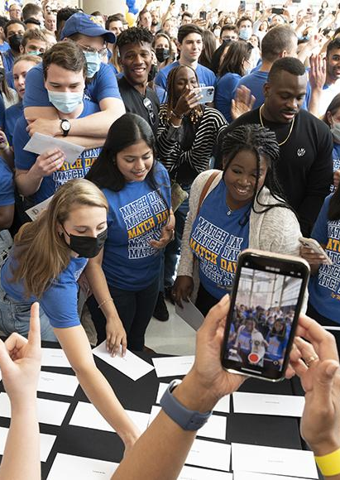


3RC Phase 3
Formation

Slide 5
3RC Overview
Views
  Student Experience
  Faculty Experience
  Administrative Team
Final recommendations
Questions & Discussion

Slide 6
Student Experience: What are the major changes?
Case-based integrated 15-month curriculum
  Active learning in small groups
  Guided by longitudinal educators
  Themes threaded through 4-year curriculum (Threads)
    Clinical Reasoning
    Interprofessionalism (IPE)
    Social Medicine
    Leadership
Flex weeks built into the calendar for individualized experiences
Notes:
Rachel
Next two slides: broad overview of the major curricular changes, more detail to follow later in presentation
Students will spend most of their structured time in small group learning environments with dedicated educators who they will come to know over time as teachers, mentors and collaborators in building a learning environment where the students flourish. The weeks within the Foundations (pre-clinical) segment follow the same structure and cadence throughout the segment.
Flex weeks built into the calendar allow students to have dedicated time away from the curriculum for remediation, wellness, research, shadowing, CAP, etc.

Slide 7
Student Experience: What are the major changes?
Community Alliance Program (CAP)
  Small groups of students paired with a community org
  10 small/large group sessions in pre-clinical years
  Integrates with social medicine and interprofessional threads
  Will work with Office of Community Health once established
Longitudinal Alliance Program (LAP)
  Each student paired with one patient
  Creates longitudinal relationship with students and patients
Notes:
Rachel
New CAP program
Students paired with community orgs focused on improving health disparities or some other health
Will spend few hours a month working with this org throughout med school
Current LAP program expanded for all students
1 student, 1 patient
Students will attend patients' med appointments, get to know the pt and get a sense for what it is like living with XYZ medical condition
Few hours per month, depending on the pt

Slide 8
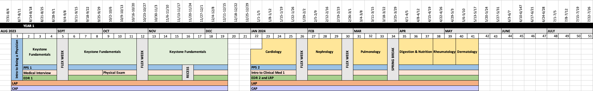
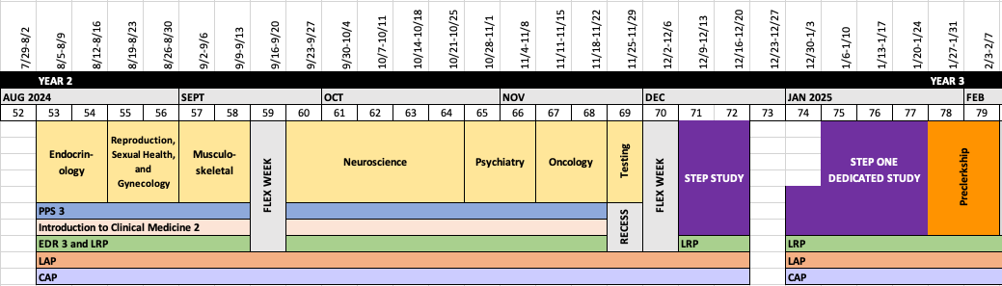
Overview of the Pre-Clinical Curriculum
Notes:
Nathalie
Curriculum is shortened --> take step 1 in january
Keystone foundations is integrated, each week has a new case to cover fundamentals
Organ systems stay separated but curriculum is also case based
Longitudinal courses --> Patient, Physician, Society (PPS), clinical medicine courses, EDR and LRP, new LAP, new CAP
Flex weeks throughout
We'll start with an overview of the pre-clinical curriculum:
You'll see that the curriculum is shortened, with students taking step 1 by the end of January
The Keystone Foundations courses are now integrated and case based. Each week of the foundations curriculum will have a new case to cover fundamental topics
The organ systems courses will stay separated, but the curriculum will also be case based
Like in the current curriculum, there are several longitudinal courses – including Patient, Physican, Society (PPS), clinical medicine courses where students learn clinical skills, EDR and LRP, and the new LAP and CAP programs
You can also see in the schedule that there are several flex weeks distributed throughout the curriculum where there will be no course content delivered. We'll discuss these flex weeks later in our presentation

Slide 9
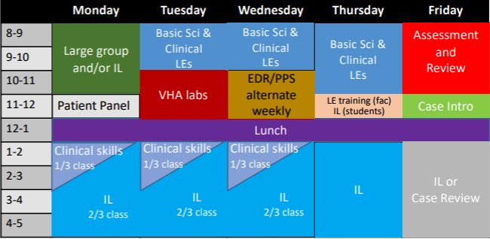
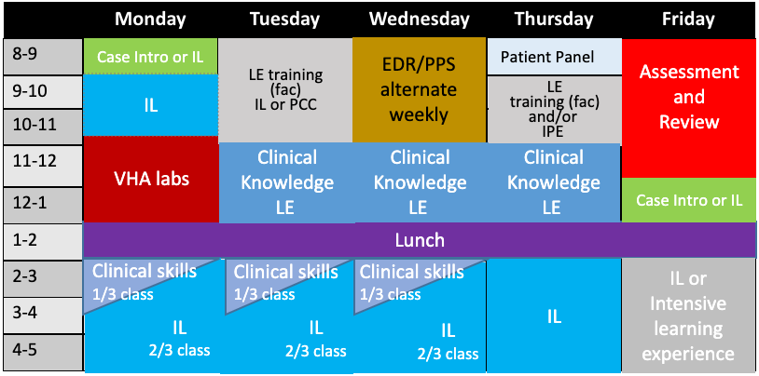
General Weekly Schedule
Keystone Foundations
Keystone Organ Systems
Notes:
Nathalie
This is a general weekly schedule
LE guided small group sessions are Tue/Wed/Thr mornings
Cover case content
EBM/PPS alternate on wednesdays
VHA – visual human atlas --> larger group setting to learn anatomy, histology, pathology, and radiology
PCC will be mon/tue/wed afternoons, students are assigned to one day a week
Weekly assessments --> either a formative quiz or a summative exam
Now we'll take a closer look at what the general weekly structure will be
The foundations and organ systems weekly schedules are essentially the same with some minor differences
Generally, there will be longitudinal educator guided small group sessions on Tue/Wed/Thr mornings
These sessions will cover case content and on wednesdays will also include alternating EDR and and PPS sessions
The VHA is the visual human atlas where students will work in larger groups with content leads other facilitators to learn anatomy, histology, pathology, and radiology
The clinical skills course will run on Monday/Tue/Weds and students will be assigned to one day a week
Each week will end with an assessment that is either a formative, ungraded quiz or a summative exam, which will be followed by a review session

Slide 10
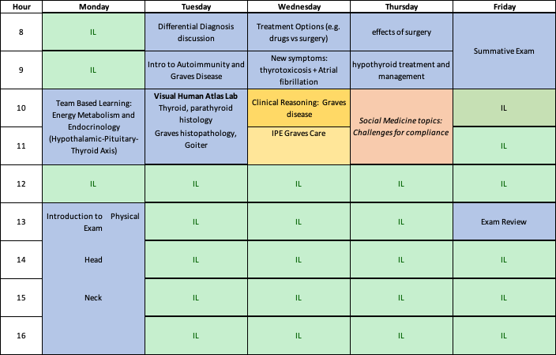
Student Experience: Example Week – Weight Loss and Fatigue
CAP
LAP
Notes:
Nathalie
Let's walk through an example of a week in a student's life in the 3 rivers curriculum
Lets fast forward to the fall. It's the end of October and the leaves are changing. Heather is an MS1 – it's a new week and so there's a new case. Heather and her class were introduced to this patient last Friday. They learned that their patient, a 28 yr old female, presented to the clinic complaining of weight loss and fatigue. Over the weekend, she thinks about this case and what the diagnosis could be.
On Monday morning, she reviews some videos produced by the content lead on the thyroid and thyroid disorders.
There is no patient panel this week and so she goes to the large group learning session held by the content lead to learn about the Hypothalamic-Pituitary-Thyroid Axis, thyroid hormone biochemistry, and the cell biology of membrane trafficking and hormone synthesis
Heather has her clinical skills course on Mondays and so after lunch she works with her small group, her longitudinal clinical skills preceptor, and a standardized patient to learn how to perform a physical exam on the head and neck
On Tuesday morning she meets with her small group and her longitudinal educator to develop a differential. Heather has worked with this same longitudinal educator and small group for the past couple of weeks and so feels comfortable throwing out a couple ideas for the differential diagnosis.
They discuss what labs that they would want and what a thyroid scan and uptake study is. Heather asks a question about the thyroid scan that the LE isn't sure about, so they get the attention of the content lead out in the hallway to ask the question.
They learn results of these tests and diagnose the patient with Graves Disease.
Heather and her classmates then move to the VHA session where she works with her classmates to review thyroid and parathyroid histology with the help of the content lead and several other session facilitators
In the afternoon, Heather's LAP patient has a doctor's appointment and so she meets with her patient to go to that appointment
On Wednesday morning , Heather meets with her small group and LE again to discuss new symptoms the patient has developed. In the case, the patient presents to the ED with shortness of breath, pedal edema, and tremor. Heather and her group discuss the differential diagnosis for these new symptoms and possible treatment options. In discussing these, Heather and her small group review clinical reasoning skills and the role of interprofessionalism in Graves disease care.
Heather has a CAP group meeting that day. She has a spanish minor from college that she is interested in putting into use in medical school. Her CAP project is focused on ensuring adequate interpretive services for patients and is coordinated through Casa San Jose. That afternoon she and her groupmates meet with their Casa San Jose mentor to discuss their ideas for making their project sustainable.
On Thursday morning, Heather meets with her small group and LE to discuss how the case patient is doing 2 years later. The patient had thyroid surgery and now 6 weeks post op is having hoarseness, fatigue, and weight gain. Heather's small group discusses the differential for these new symptoms and decide on a management plan. Heather's group also discusses how social determinants of health impact treatment compliance .
Fridays, like every other week, are an assessment day. Last week was a formative, ungraded quiz, but this week has a summative exam that covers topics from the previous weeks' cases. After finishing the exam and having lunch, Heather joins the exam review session led by the content lead
--------------------------------
This particular week is Case 6: Grave’s disease that sits prior to a Flex Week. The first-year student begins with a case introduction on Friday after assessments. This initial introduction may begin with a brief patient description, history and perhaps presenting complaint. This sets the stage for the next week of integrated education.
Monday morning, students will begin with team-based learning (TBL) followed by independent learning and a patient panel. Students Patient-centered care content will occur in the afternoons (one per week), facilitated by longitudinal Clinical Skills Preceptors. Tuesday will begin the small groups with Longitudinal Educators followed by lab time exploring the Visual Human Atlas (VHA). After discussing treatment options and new symptoms on Wednesday morning, students will switch to [topic from EDR or PPS). This too is a standard slot for integrating thread, research, and society content. Thursday's small groups send students to prepare for the summative assessment Friday morning. This 90-question exam will include vignettes and will be written by faculty and approved by a new Assessment Subcommittee of the CUrriculum Committee and will utilize criterion-referenced standard setting methods. The students will gather for a review immediately after the assessment. Friday afternoons are open for remediation, independent learning, or case review. In this particular case, the next week is a flex week

Slide 11
Student Experience: Flex Weeks
Shadowing
Research
Professional Enhancement (PEC)
Community Service
Professional Development
Wellness
Remediation
CAP
LAP
Notes:
Rachel
Heather example: Flex Week
Heather has been looking forward to this flex week since she started working with the Guerilla Eye Service last month. She is curious about ophtho and has signed up to take an ophtho PEC this week.
Each day, Heather will have roughly a half day of PEC content, as well as plenty of IL time. She plans to help staff a community health fair that her CAP nonprofit is organizing on Tuesday morning. She will also attend her LAP patient's prenatal appointment on Friday afternoon.
Some of her peers have scheduled other opportunities for this week, like shadowing, research, etc.

Slide 12
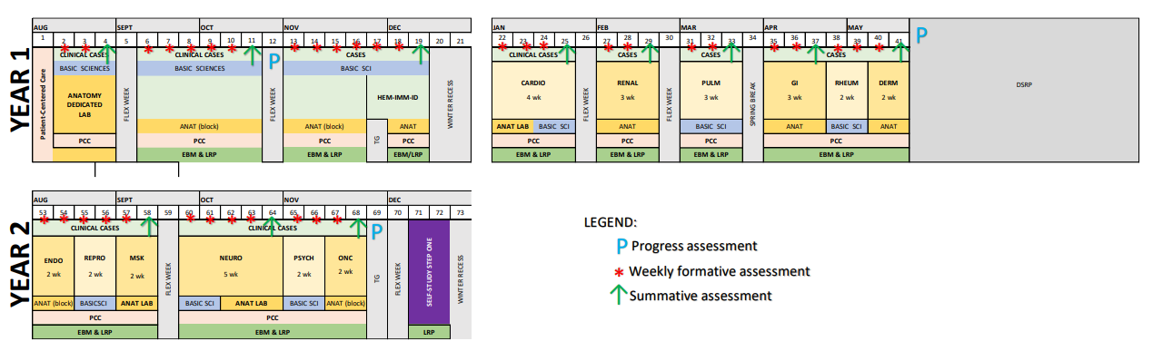
Student Experience: Assessments
Weekly Formative Assessments
12 Summative Assessments
3 Progress Tests during the first 15 months
Notes:
Greg: do you want to address Assessments only here, or also in slide 21

Slide 13
Student Experience: Remediation
Normalization of learning resources
Post-formative assessment outreach
Summative assessment failure
  Student Success Team notified
  Remediation begins (flex week, IL time, break, summer)
  Secondary assessment in failure area only
1st year completion by mid-July
2nd year completion by Preclerkship Week
Notes:
Greg
First we expect that all students will interact with the learning resources that the school provides (coaches, tutors, office hours, etc). While not graded, students who do not meet the standard in formative assessments will be contacted by the Case Lead to discuss result and resources. In the event that a student fails a summative assessment, remediation will begin and can occur during flex weeks, IL time, breaks, or summer. A student who fails four summative assessments will be referred to Promotions. In order to move to to move to the second year, students must successfully complete remediation by mid-July. In order to enter clerkships, students must complete remediation by Preclerkship Week. Students will be evaluated using secondary assessments, similar in validity and reliability to the initial summative assessments and will only remediate in areas where they failed.

Slide 14
Clerkships and Bridges
Changes to core clerkships:
  Surgery = 8 weeks
  OB/GYN = 6 weeks
  Anesthesia moved to MS4
  AOMC moved to MS4 (may be fulfilled with LCE)
  Removal of Specialty Care
Acute Care Elective (MS4)
  Strongly recommended
Ophthalmology/Otolaryngology
  Content to be integrated into all four years of curriculum
  Includes time within cases, clinical sites, electives etc.
Longitudinal Clinical Experience (LCE)
  One-year ambulatory experience in MS4
  Six Tracks: IM, FM, Peds, Surg, OB/GYN, Psych
  Students in IM, FM track may be exempt from Outpatient IM Clerkship
Notes:
Rachel
Clinical curriculum still being sorted out
Changes so far:
OB/GYN= 6 weeks
Surg= 8 weeks
Anesthesia moved to MS4/Beyond
AOMC moved to MS4/Beyond (may be fulfilled with LCE)
Specialty Care going away, content to be integrated throughout
Addition of acute care elective (EM, CCM, etc.) - strongly recommended
LCE: ½ day in LCE clinic at least 2x/month (except when student is on AI, acute care block, or away from Pittsburgh)
Student will rank their "bucket"/track choices, will be placed in a clinic ideally in one of their top choices
Can choose to do an LCE in their probable field or can do something totally different

Slide 15
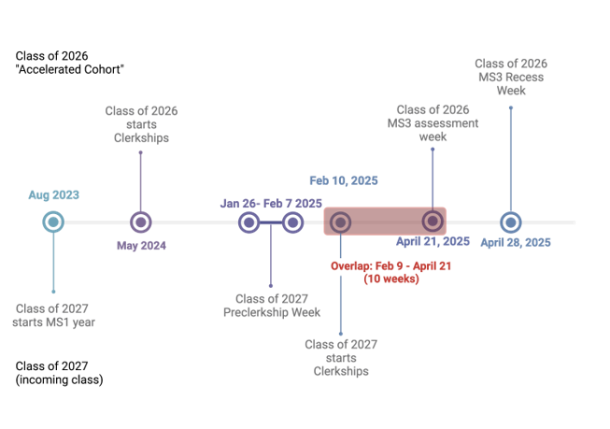
Legacy Cohort

Slide 16
Legacy Cohort
Ten-week overlap of legacy and 3RC students
    Working Group recommended possible solutions to minimize burden on faculty/clinical sites, maximize student learning
    Best option:
      Legacy cohort will shift AOMC and Specialty Care to MS4 (timing flexible)
      3RC cohort will skip the 2 flex weeks that are built into the new calendar in the clerkships phase and will instead have 2 extra weeks at the beginning of the clerkships phase to create an extended pre-clerkship experience or other clinical experience
Pilot of Longitudinal Clinical Experience during MS4
Notes:
Rachel
Legacy working group came up with several possible solutions to accommodate the different timing for the Legacy cohort and the first 3RC cohort
If no changes, would have 10 week overlap
CDs felt they could not accommodate more students
Students and CDs felt that shortening the legacy cohort's clerkships uniformly would be detrimental to learning and hard on CDs
Plan: Legacy cohort will shift AOMC and Specialty Care to MS4 (timing flexible), 3RC cohort will skip the 2 flex weeks that are built into the new calendar in the clerkships phase
Legacy Cohort will also have the opportunity to pilot the LCE during their MS4 year (30-50 students)

Slide 17
Primary Care Accelerated Track (PCAT)
3-year accelerated program for IM, FM, and Peds
  7 student capacity
  Students will be ranked to match to UPMC
Program starts in July
PCAT students have additional courses and activities to maintain standards and achieve competency
  Summer courses (Community Health, Clinical Skills, and Health Care Systems)
  Specific flex week activities
  Clinical continuity experiences
Students can change their mind
  Can opt out of matching with UPMC
  Can drop out of the PCAT
5 students matching into IM and FM in AY23-24
Notes:
Nathalie
The primary care accelerated track or "PCAT" is a 3 year accelerated program for students committed to internal med, family med, or pediatrics.
This program can take in 7 students that will be ranked to match to UPMC upon successful completion of the program
The program starts in july and has several additional courses and activities to make sure the students achieve competency with their accelerated program
These include a summer course series, specific flex week activities, and longitudinal clinical experiences
Students can of course change their mind after entering the program. They can opt out of matching with UPMC and they can also drop out of the program entirely if they find that their interests have changed
This year we will have 5 students entering into the program for IM and FM.
Peds will start accepting students next year.

Slide 18








Faculty Experience
Protected time focus on educating students first 15 months
Longitudinal relationships with students
Professional Development
Notes:
John

Slide 19



Faculty Experience
Clinical Skills Preceptors:
  Mon, Tuesday and Wed pm
Longitudinal Educators:
  Tue, Wed, Thursday am
Leadership faculty
  ~.5 day a week on average over M1-2
  Weekly time varies with calendar
    More during weeks of topical focus education
Notes:
John

Slide 20
Faculty Leadership
3 Block Directors (0.1FTE)
  Keystone Fundamentals; Organ Systems; Patient-centered Care
20 Content Leads + 4 Educator Leads (0.1 - 0.2FTE)
13 Organ Systems Course Directors (0.1FTE)
4 Thread Leads (0.1-0.2FTE)
  Clinical Reasoning; Leadership; Interprofessional Education; Social Medicine
Program Leads (0.1-0.4FTE)
  Community Alliance Program; Longitudinal Alliance Program; Primary Care Accelerated Track
Notes:
John

Slide 21
Faculty Leadership
Responsible for content in area:
  Understanding where it happens in the curriculum
  Integration across curriculum
  Leading creation of content
Collaborating/Coordinating with other leaders
  How do we work together to support activities that integrate content
  How do we introduce, develop and reinforce content
Supporting Longitudinal Educators
Coordinating curriculum during case weeks
Notes:
John

Slide 22
Faculty Experience
Begin training in summer 2023
  Small group teaching skills
  Training on curriculum
  Preparation for cases in early weeks of term
Small group teaching
  Supported by content area leadership
  Focused on education
    Assessment and grading is through other means
  Can integrate “guest faculty”
    Gaining experience
    Bringing perspective
Notes:
John

Slide 23
Assessments WG
Director of Assessment and Assessment Subcommittee
Assessment approach: Comprehensive assessment of medical knowledge throughout foundations and organ systems phase
  In-house written vignette-style MCQ in all assessments
  Reliable and valid remediation assessments
  Shared item analysis (KR20, % correct, point-biserial, etc)
  Mandatory student review
  All questions mapped to Educational Learning Objectives
Notes:
Greg: A director of assessment and the work of the Assessment Subcommittee will vet summative assessment questions and will work with case lead collective to write reliable and valid test questions for all assessments. Item analysis, currently shared with course directors, will be shared with leads/course directors, block directors, and the Subcommittee. A mandatory review will be scheduled after each assessment. All questions mapped to EPOs

Slide 24
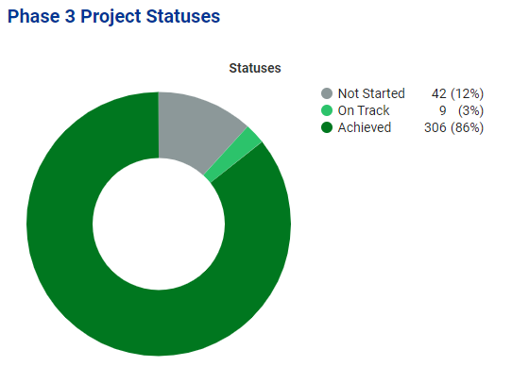

Notes:
Greg: a reminder as we transition to the administrative realm, that we documented 306 achieved deliverables in AchieveIt, with a plan to complete the other during Phase 4.

Slide 25
Administrative
Staffing
  CAP office creation and hiring
  Two instructional designers – one hired, searching for other
  OMED restructuring office to better serve SOM
    Four new staff to be onboarded over spring/summer
    Transition of current position tasks to take place March-August
    LMS, LE/CSP prep, learning new courses, program evaluation, mapping and integration, facilities management, operational planning

Slide 26
Administrative
Educational Technology
  New Learning Management System – Elentra
    Some functions will move to Elentra, others will stay in current systems
  Progress IQ for tracking student progress in curriculum
  Slack for student communication
  Consider growth opportunities for AR/VR
Mapping and Integration
  Content to be mapped in Elentra
  Visibility for how and where content is delivered
  Recommended content to map (EPOs, keywords, assessment methods, etc.)

Slide 27
Administrative
Scheduling/Logistics
  Created calendar for all four years of curriculum
  Work to continue with HS IT to streamline registration, lottery, etc.
  Work to continue with University Registrar to ensure compliance
Program Evaluation
  Developed a plan for evaluation of first year of 3RC and overall program
  Review course and clerkship evaluation process
  Continues to review how Program Evaluation aligns/divides from CCQI and accreditation processes
Notes:
A full calendar of all four years was created and approved during Phase 3. The goal is to keep to our procedure of having all schedules, courses calendars, etc available to students 30 days prior to the course/educational learning experience. Current registration and lottery function must be streamlined and groups from SOM are meeting to plan future steps. In addition, OSA and OMED members are meeting regularly with the University's Registrar to smooth current link to their official documents.
Data from curriculum will be continuously monitored using a three-tier system (course/case, segment, whole curriculum). Enhanced indicators will be gathered and shared with CCQI, Assessment, and other diverse groups as it becomes available. In addition, a group of faculty, staff, and students will meet Fridays to debrief the week, review needed data, and course correct as needed during this initial launch.

Slide 28
Administrative
Policy
  34 current policies required updates; 28 remained as is
  Updated policies continue to be voted on by CC
  Recommends policy review committee and annual review of 1/3 of policies
Finance
  AY23-24 estimated to be ~$6.5m
  Increases to ~$9m annually in subsequent years
  ECUs no longer collected – departments will still receive supplement from Dean's Area annually

Slide 29
Work to continue
We feel that Curriculum Reform should continue to Phase 4
  Need to finalize Streams
  Delayed Working Groups
    ILS, Credit System, and Diagnostics to begin work in Phase 4
We recognize that our recommendations may change in Phase 4 or in the execution of the curriculum beginning this fall
Final written report will be sent Wednesday

Slide 30
Questions?

